Slide 1
R Bootcamp: For Newcomers to R Predictive Analytics world 2019
Instructor: Brennan Lodge

Slide 2

Instructor: Brennan Lodge

Slide 3

Background<
10+ years industry experience
Banking / Finance / Media / Tech
Cyber Security
Analytics
MSBA ‘15 Stern School of Business NYU
Capstone: Predicted churn for members of a non-profit Arboretum
DataKind
Predictive Analytics to personalize Health Care
Technical Advisory Board member
Notes:
Ok a quick blurb on me…
- I hold a masters degree @ NYU in business analytics. We were introduced to R in one of our first classes and I immediately enjoyed the statistical programming langue. It just spoke to me and I was able to grasp it pretty quickly. I compare R to some of SQL and some of python. But it does stand on its own. Its very reactive and response driven with immediate feedback. There is a very strong support in the academic, research, open source and development community. There are endless options, packages and the visualizations are really the icing on the R cake .
- Ok.. A bit about my data science background. I am a data geek. This stuff excites me and I'm really happy to share what I know about R with you guys. I've worked on a number of data related projects some small some big. A few big ones include my research in grad school which helped a non-profit Arboretum in Chicago understand churn for their members. The project consisted of a prediction algorithm to understand if the members of the arboretum would renew membership. Churn then would be the evaluation of customers not renewing their membership. We were able to collect multiple data sources, like demographics, attendance, purchases, engagement in events at the arboretum, etc at the arboretum and determine at about 80% accuracy on weather their members coming due for membership would renew or churn. It was a fun project that helped the non-profit learn their customer base and learn how to target their marketing strategies to better retain their members.
- I am also currently involved and partnering with Bloomberg Philanthropies, a data science non-profit called DataKind and the target company of Thresholds which is a non-profit mental healthcare provider in Chicago. I'm on a team with 3 others and we are working on a prediction algorithm to assist with determining high risk mental health patients in the Chicago area. We’ll be presenting our project at the Bloomberg Data for Good exchange on September 25th.

Slide 4

getwd()<
summary(Brennan.Lodge)
Notes:
My twitter handle is @blodge8
I love to travel, I am from the Philadelphia area and love all the Philadelphia sports teams. I play water polo and swim of course. I went Temple for my undergrad and NYU for graduate school. I am dabble in cyber security at my

Slide 5
Section 1<
Course Layout:
Section 1 –R intro
Class overview
Installing R
The IDE
Researching and best practices
R help
R Packages
Review Exercise 1
Hands on exercise
https://stat.ethz.ch/R-manual/R-devel/library/base/html/Memory-limits.html
Notes:
More on the nuts and bolts or under the hood of the R engine here.
R stores all objects in memory
It can process 8TB of RAM on 64bit operating systems
Rules of the Road for Big Data and R
R can process up to 1 million records with ease
For greater than 1 million and less than 1 billion records, R may struggle to process the data
If you’ve got greater than 1 billion records, its best to use big data platforms that leverage map reduce and processed on big data platforms like Hadoop
Memory Limits in R
https://stat.ethz.ch/R-manual/R-devel/library/base/html/Memory-limits.html

Slide 6
Agenda for Session 1
Class Format
R Background
R Intro
R Studio

Slide 7
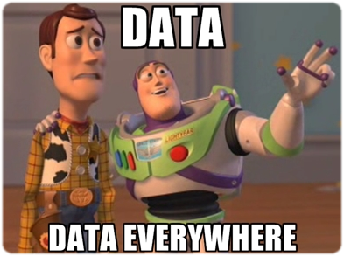
Big Data <
Notes:
Before we R <GO> first with Big Data <GO> first
As most of already work in Big Data we here about it very often. Almost too often.
What is your best definition of Big Data.
Marc “an-DREE-sen” sums up Big Data, I think the best, in this quick quote
“ We have surrounded ourselves with machines that convert actions, thoughts, and emotions into data- raw materials for armies of code-wielding engineers to manipulate.”
…very Orwelian right? Is this true?
R is a great engine to store this data power. And it should be used wisely. With great power comes great responsibility – Spider man quote.
With Big Data comes Big Responsibility.

Slide 8
Data Science <
Data Science is the study of the generalizable extraction of knowledge from data
Notes:
fundamental concepts, and having frameworks for organizing data-analytic thinking not only will allow one to interact competently, but will help to envision opportunities for improving data-driven decision-making, or to see data-oriented competitive threats.

Slide 9
R for Data Science <
The goal for this class is to empower you to turn raw data into understanding, insight, and knowledge.
R is simply a tool that will allow you to do data science
KNOWLEDGE IS POWER

Slide 10
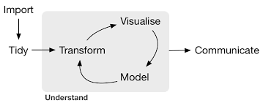
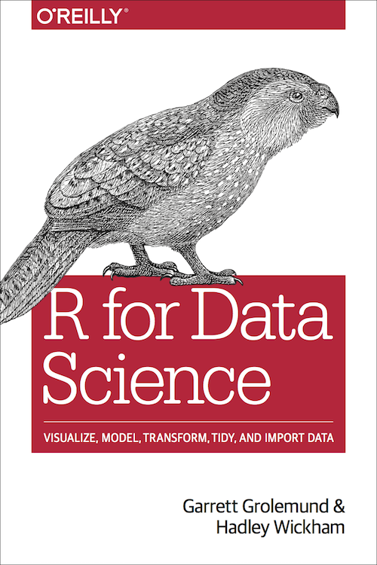
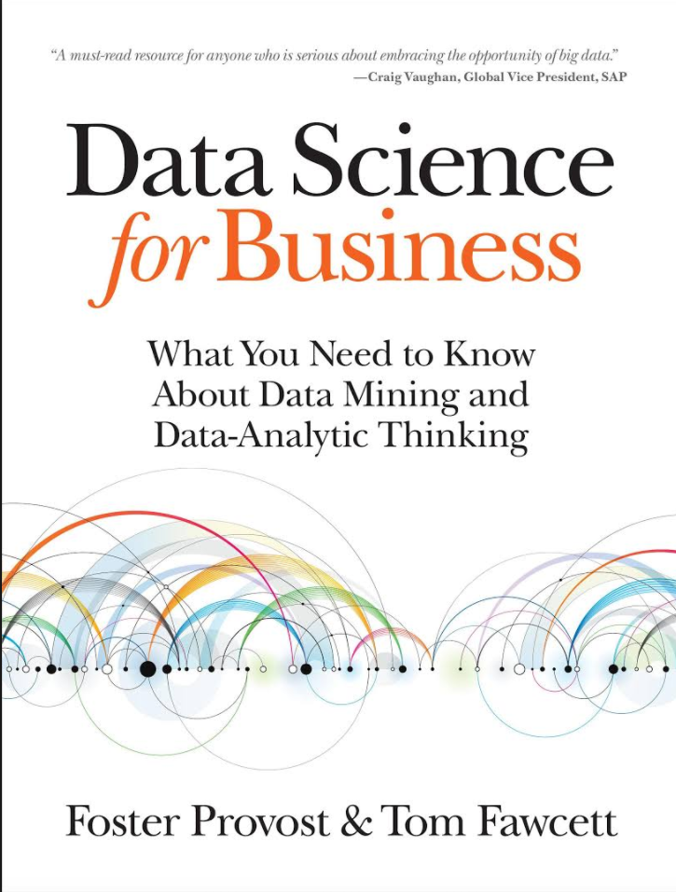
Format going forward<
The format of the course onward will be broken out by the typical data analysis process explained by Hadley Wickham, author of “R for Data Science”
Each data “problem” should be answered in this model
80% of the heavy lifting in this model will be within the following sections Import->Tidy-> Transform
http://r4ds.had.co.nz/intro.html

Slide 11
Import <
Take the data store in a file, data frame or web api and load it into a data.frame in R.
If you cant get the data into R, then you cant do data science

Slide 12
Tidy <
Cleaning the data and storing it in a consistent form that matches the semantics of the dataset with the way its stored

Slide 13
Transform <
Narrow in on observations of interest, creating new variables that provide calculations or summary statistics

Slide 14
Visualization <
Require human interpretation and are fundamental in describing data

Slide 15
Models <
At the surface they are a mathematical or computational tool
Scaling the model can be difficult

Slide 16
Communication <
The ability to articulate and provide value to the end product of your data analysis

Slide 17
Not Data Science <
Data Warehousing – collection and storage of data
Querying – SQL and any GUI clicking
Statistical Analysis – hypothesis generation or testing. “A” “B” testing
No Microsoft Excel here

Slide 18
> R
Notes:
R you ready?

Slide 19

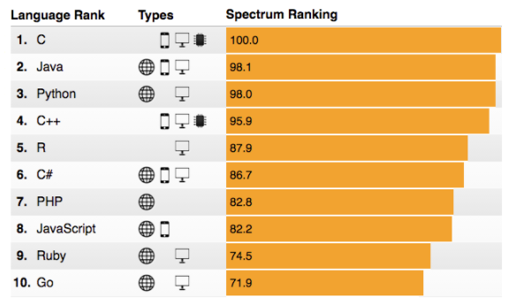
History<
The R statistical programming language is a free open source package based on the S language developed by Bell Labs. Evolved to R in 1997 with source code and packages available on CRAN and is a GNU project
R is interpreted computer language used for data manipulation, statistics, and graphics.
In April of 2015 Microsoft acquired Revolution Analytics, the commercial provider of software and services for the R programming language
http://www.datasciencecentral.com/profiles/blogs/r-moves-up-to-5th-place-in-ieee-language-rankings
R 1 spot from 2015
Notes:
Where does R come into play for all this Big Data? Here's a breakdown for your history buffs out there. R is a statistical programming language built by statisticians for statisticians.
Some say the best thing about R is that it was written by statisticians. Others say the worst thing about R is that it was written by statisticians and not developers.
It was built in Bell Labs and was originally called “S.” Now if you ask me, when you are planning to release a new version of a product or programming language you would go with the proceeding letter in the alphabet and not the letter before it, or “R”
Anyways, it evolved to R in 1997 with source code and packages available on CRAN and it is a GNU project.
CRAN – comprehensive R Archive Network
Stats – started with roughly 12 packages. Now at 8,485 (May 24, 2016)
Ill open this shiny app here which is a real-time view of R packages being downloaded in the last 5 minutes. We’ll be developing a shiny app later in this class as well. But this best represents the popularity of R and its future growth.
Stream of downloading packages for R –
CRAN package downloads
https://gallery.shinyapps.io/087-crandash/
As for WHY R? Well lets compare the side-by-side against its arch nemesis, python.
R vs Python example:
https://www.datacamp.com/community/tutorials/r-or-python-for-data-analysis#gs._m3kPls
OR
http://blog.datacamp.com/wp-content/uploads/2015/05/R-vs-Python-216-2.png
- In code repositories, there's a great quote here by a professor of computer science, “I don’t see Python building up a huge code repository comparable to CRAN. R has a gigantic head start, and statistics simply is not Pythons central mission.”
For comparison on jobs using R…be the shark, people!
General – when doing Kaggle or the data science hackathon competitions, the participants are mostly using R to win.
Support – The community in stack overflow are asking and answering a lot of questions about R
Job trends are obviously up for R
Visualizations – This is really where R separates itself from Python and the rest of the pack. It far exceeds its capabilities for visualizations available and packages that support visualizations.
In April of 2015 Microsoft acquired Revolution Analytics, the commercial provider of software and services for the R programming language
Why tho? Well Microsoft realized that at the time, more than 2 million people worldwide have been using R as the statistical computing and predictive analytics programming language
R is enterprise-ready with speed and scalability for big data warehouses like Hadoop systems
Microsoft will integrate R into its Big Data platforms – Azure
http://www.cio.com/article/2906456/data-analytics/microsoft-closes-acquisition-of-r-software-and-services-provider.html

Slide 20
R explained <
R stores all objects in memory
R can process 8TB of RAM on 64 bit operating systems
R Rules of the Road
Can process up to 1 million records with ease
For > 1 million && < 1 billion records, R may struggle
> than 1 billion records, its best to use big data platforms that leverage map reduce and processed on big data platforms like Hadoop
https://stat.ethz.ch/R-manual/R-devel/library/base/html/Memory-limits.html
Notes:
More on the nuts and bolts or under the hood of the R engine here.
R stores all objects in memory
It can process 8TB of RAM on 64bit operating systems
Rules of the Road for Big Data and R
R can process up to 1 million records with ease
For greater than 1 million and less than 1 billion records, R may struggle to process the data
If you’ve got greater than 1 billion records, its best to use big data platforms that leverage map reduce and processed on big data platforms like Hadoop
Memory Limits in R
https://stat.ethz.ch/R-manual/R-devel/library/base/html/Memory-limits.html

Slide 21
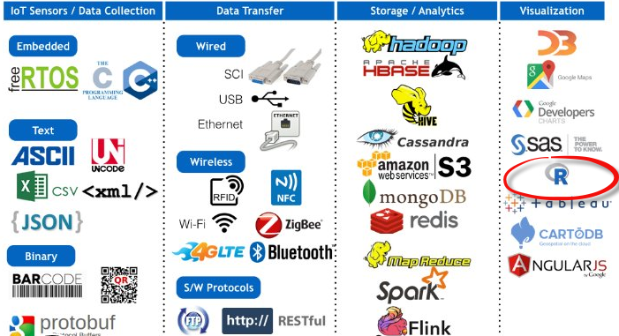
R explained part duex
Gartner IoT to Big Data Analytics Open Source Tech Stack
https://stat.ethz.ch/R-manual/R-devel/library/base/html/Memory-limits.html
Notes:
As for where R appears in the Big Data Stack, according to Gartner its further down stream in the visualization category. Even though its really more powerful than a visualization tool.
R is not the end-to-end solution and is not the infrastructure
Used for
Research purposes
Interface with other backend or big data databases
Initial analysis
Data mining
Machine Learning Algorithm building
Plotting, graphics, statistics
Handling large amounts of data
Open source development and packages

Slide 22

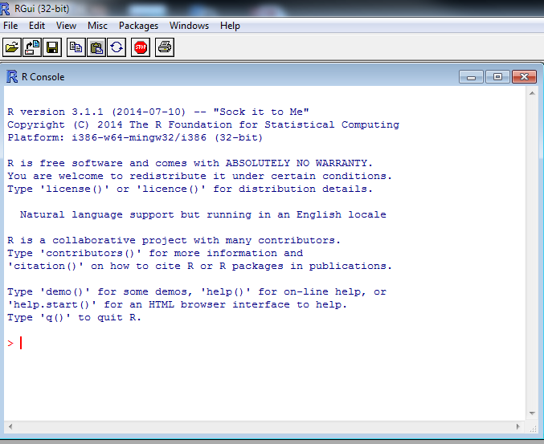
R Studio<
For instructional purposes we will be using R Studio IDE
Once the underlying R software is installed, RStudio can then be installed
Notes:
-R is the underlying statistical language, not the graphical user interface (GUI) that you use to interact with R. The command line interface is not the most powerful way to interact and use R.
-Rstudio provides a professional interface into R with an IDE (Integrated development environment) that is much easier to work with. Like R, Rstudio is free software.
Rstudio installation - https://cran.r-project.org/web/packages/R.utils/index.html

Slide 23
R Studio Install<
R Class Installation Guide:
Install R and R Studio – RStudio requires R 2.11.1 (or higher)
You'll need admin rights to perform the install.
2 Step install R > RStudio1.
1. Install R here –
https://cran.rstudio.com/
Download for your OS (Linux, Mac, Windows)
2. Install R Studio- Install RStudio here - https://www.rstudio.com/products/rstudio/download/
- Download the installer for your OS (Linux, Mac, Windows)
Notes:
More on the nuts and bolts or under the hood of the R engine here.
R stores all objects in memory
It can process 8TB of RAM on 64bit operating systems
Rules of the Road for Big Data and R
R can process up to 1 million records with ease
For greater than 1 million and less than 1 billion records, R may struggle to process the data
If you’ve got greater than 1 billion records, its best to use big data platforms that leverage map reduce and processed on big data platforms like Hadoop
Memory Limits in R
https://stat.ethz.ch/R-manual/R-devel/library/base/html/Memory-limits.html

Slide 24
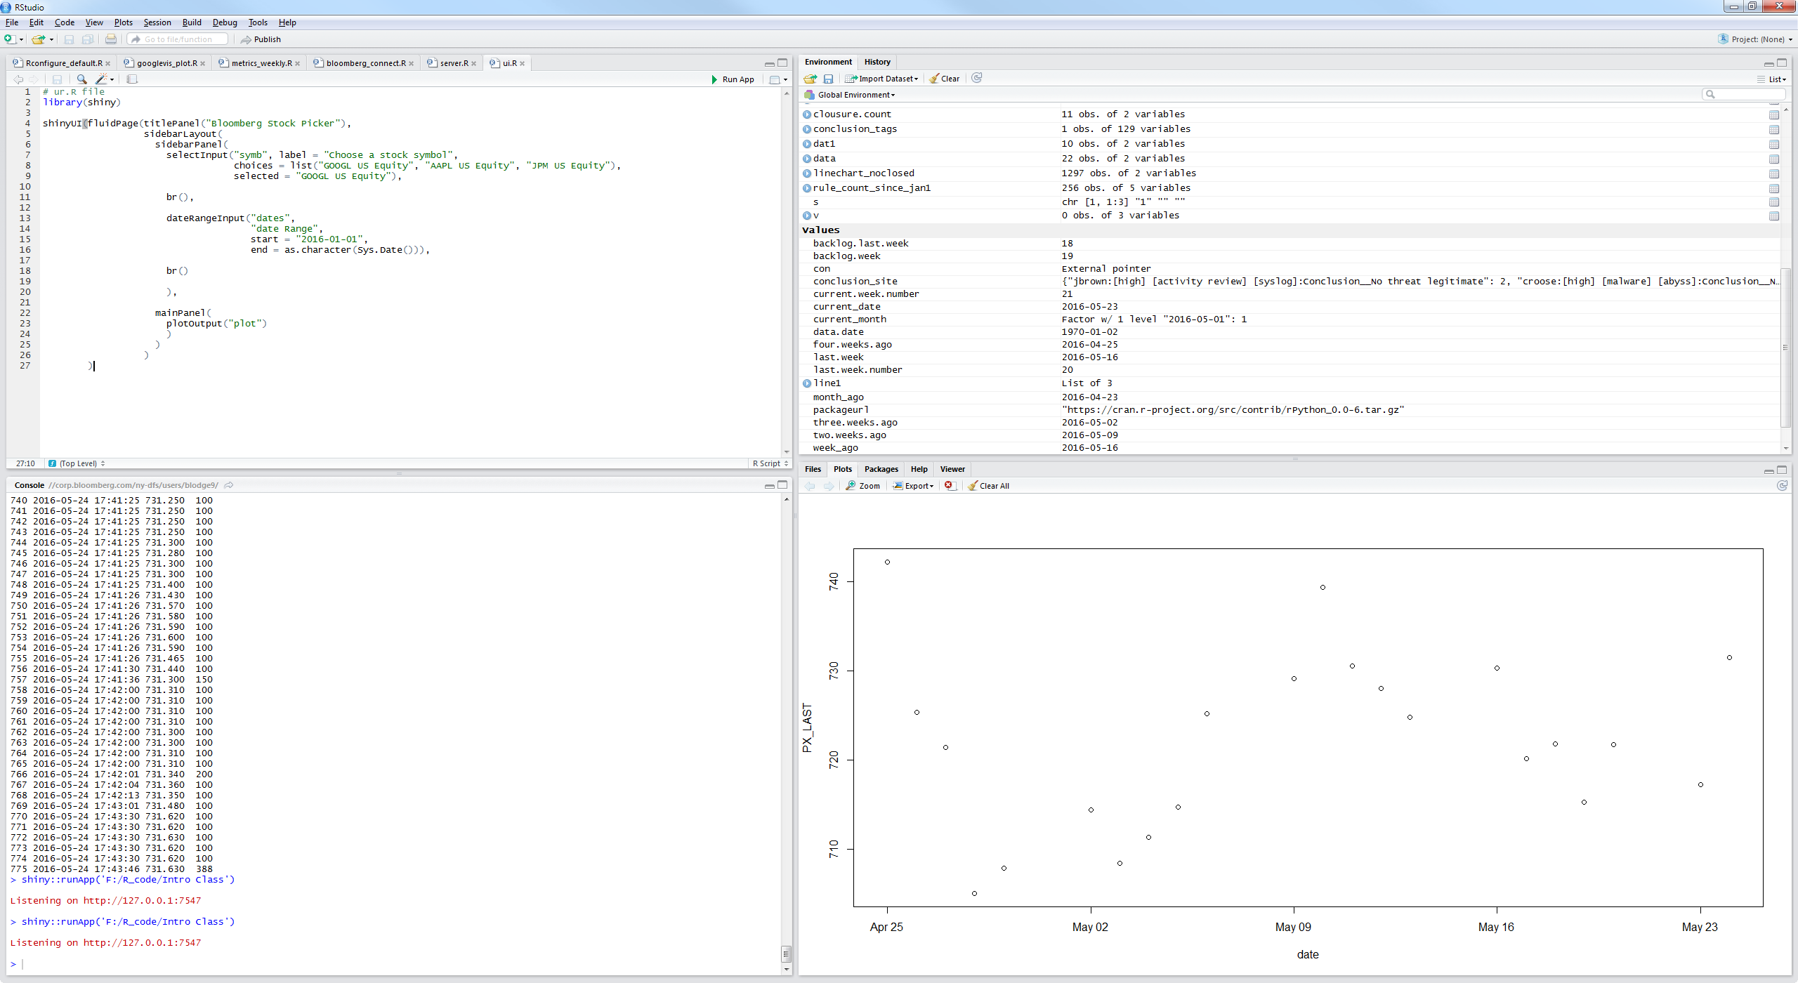
Notes:
Once R Studio is installed, the package repository will need to be created. 1. Download Package ‘R.utils’ - https://cran.r-project.org/web/packages/R.utils/index.html (keep in downloads directory)
2. Setup package directory –
## Rconfigure_default.R
library(utils)
.libPaths(c("C:\\Users\\’bloomberg username’\\Downloads", .libPaths()))

Slide 25
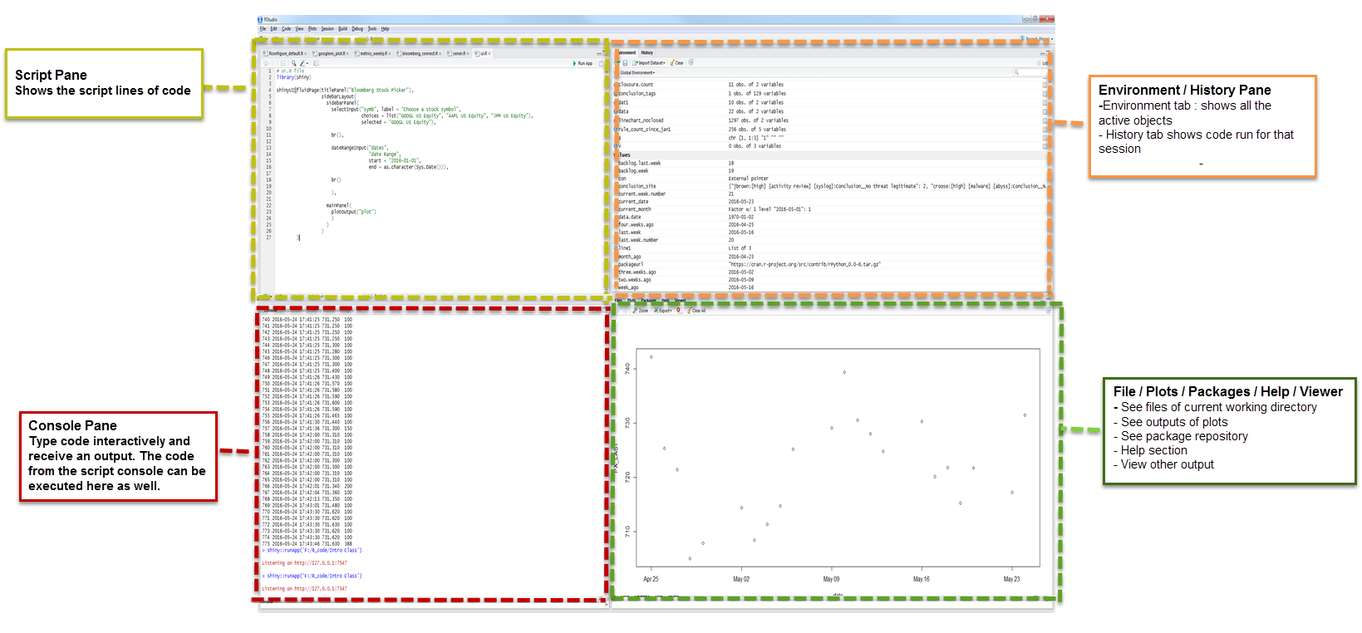
R Studio IDE breakdown

Slide 26
Starting with R
R is in fact scripting or programming
I am expecting that you have some familiarity with scripting (Bash, Visual Basic, Perl, Python, Ruby, etc)
Or have some experience with programming (C++, C#, Java, etc)
We don’t intend to write thousand line programs in this class but we’ll show how to issue R commands

Slide 27
Online R Resources
GOOGLE
CRAN - The main R site: http://cran.r-project.org
Stack Overflow R section

Slide 28
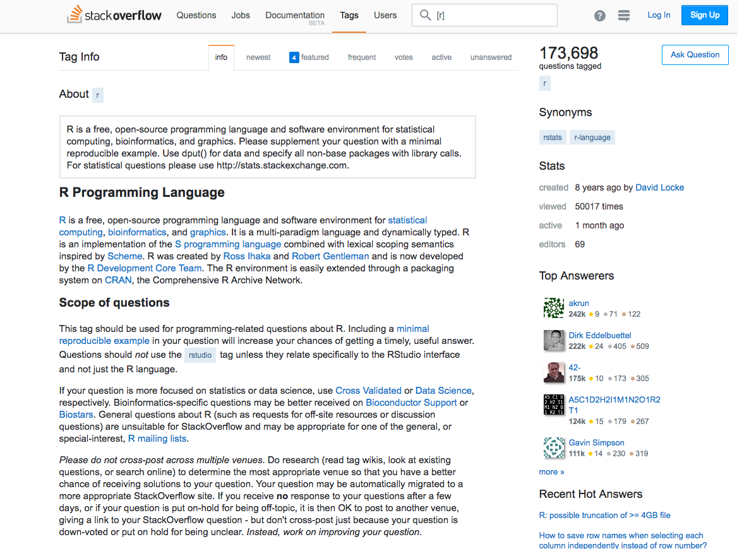

Slide 29
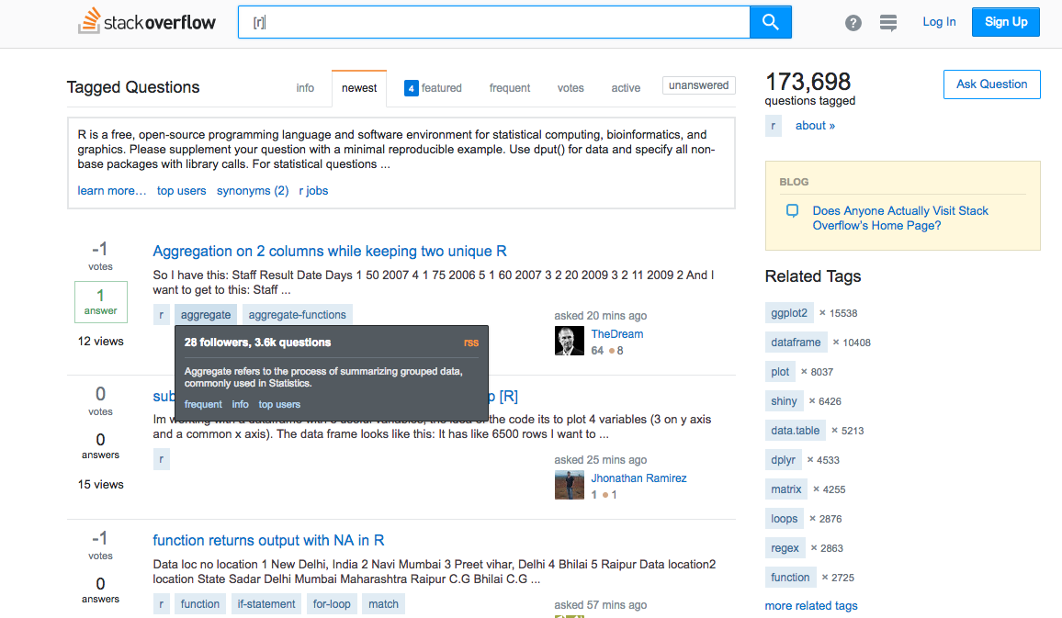

Slide 30
R best practices
Ensure your code is easy to read for yourself and others
Use spaces
Variable names should be succinct, yet informative
Use #comments
Remove any code that is unnecessary or trial code
The more concise your code, the easier it is to understand and easier to fix

Slide 31
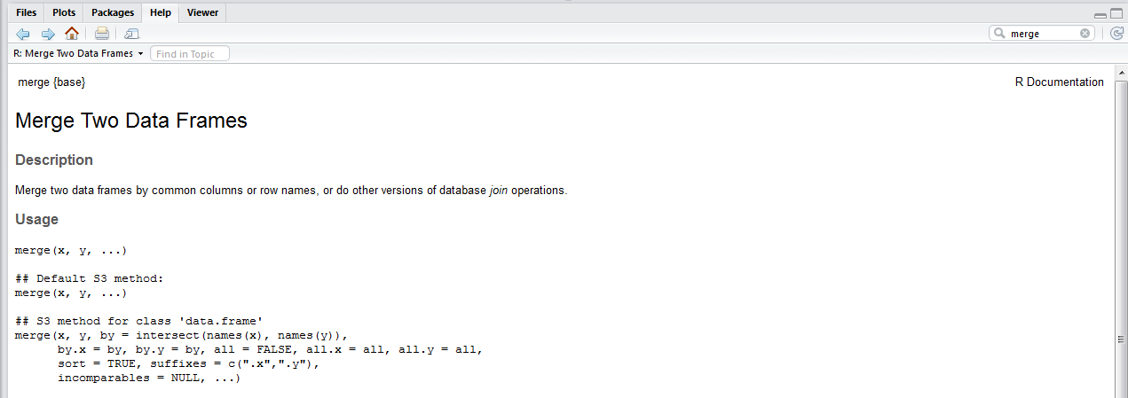
R help
R has a very good help system built in
If you need help on a package, function, etc use the Help section in the bottom right pane
Notes:
-R is the underlying statistical language, not the graphical user interface (GUI) that you use to interact with R. The command line interface is not the most powerful way to interact and use R.
-Rstudio provides a professional interface into R with an IDE (Integrated development environment) that is much easier to work with. Like R, Rstudio is free software.
Rstudio installation - https://cran.r-project.org/web/packages/R.utils/index.html
IF you get stuck, start with Google. Typically adding “R” to a query is enough to restrict it to relevant results. Useful for error messages from R
Stack Overflow

Slide 32
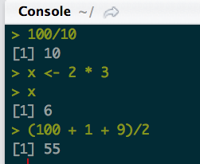
R as a calculator
The R console or standard out functions much like a calculator
Assignment statements
Object_name < value
You can mentally read this aloud as “object name gets (“<”) value”
Can use “=“ instead of “<-” but it gets confusing when you begin using math formulas

Slide 33
R tips and tricks
“>” the prompt
Keyboard Shortcut [ALT-] = “<-”
Objects
Must start with a letter and can only contain letters, numbers, “_” and “.”
Code completion using [Tab] for variables, functions, packages, etc
“+” after code generation means you are missing some syntax
Comma
Quote
Parenthesis
Press [ESC] to try again
The equal sign
• = denotes assignment, not equality.
• == denotes equality

Slide 34
R packages
The fundamental units of reproducible code.
They include
Reusable functions
Documentation
Installing and loading packages.
All of the functions that you’ll want to use in R come in the form of packages.
A package is a big collection of functions and other R objects that are all grouped together under a common name. Some packages are pre-installed in R. To learn which packages are installed in your version of R,
type: > library()

Slide 35
R packages
Installing Packages
For now, let’s install two packages: psych and ggplot2. Select the packages tab from the lower right frame. This is called the files frame (see Figure 1).

Slide 36
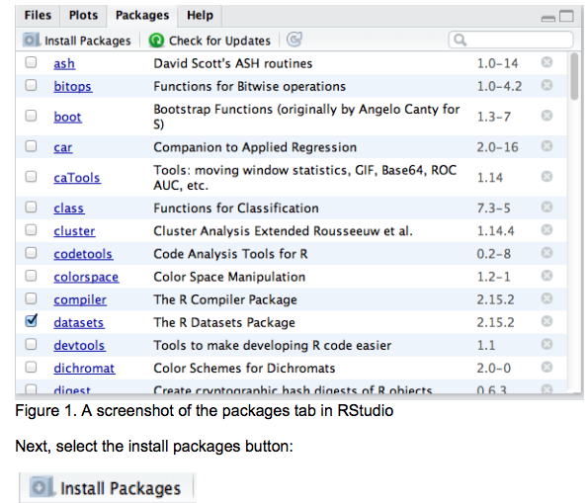
R packages

Slide 37
R packages
This will bring up a dialog box similar to the one in Figure 2.
The first drop down asks you from which R repository you would like to download a package.
The default Repository(CRAN) will work well for our purposes. CRAN stands for the “Comprehensive R Archive Network” and it is usually easiest to download a package from one of the CRAN mirror sites.
Ensure you are connected to the internet when installing packages. Next, enter the package name in the Packages field. Enter: ggplot2, psych

Slide 38
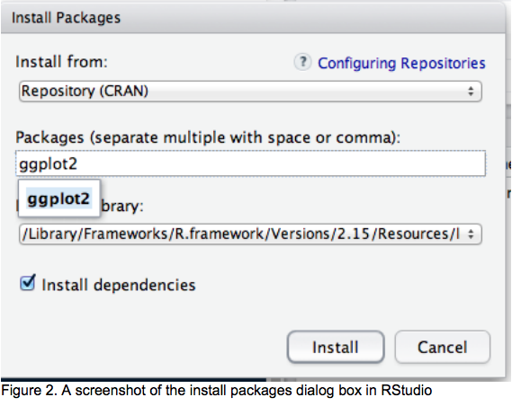
R packages

Slide 39
R packages
Loading and unloading packages
To use a package that is new to your instance of R or not selected for use by default in RStudio you need to load the package.
Simply go to the package tab in RStudio and check the box next to the packages you want to use.
Select ggplot2 and psych
You could also type the command
> library(ggplot2)

Slide 40
Your Working Directory
In R, set your working directory to a place where you will store all your data files.
In our case, let’s set our working directory to that mydata folder you created on your desktop.
This way any time you want to open a file, R will know where to look (and so will you).
You can set your working directory in RStudio by going to Session > Set Working Directory > Choose Directory, see Figure 4.

Slide 41
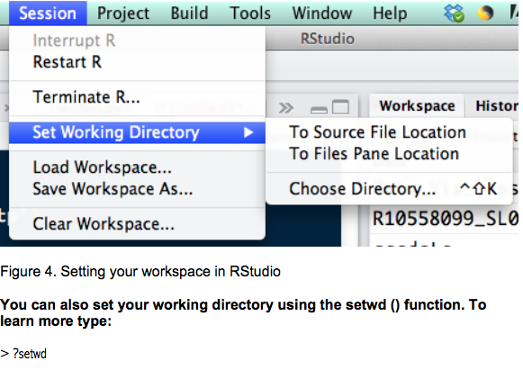
Setting your Working Directory

Slide 42
Comparisons & Boolean & NA
<
>
<=
>=
!=
==
& ”and”
| “or”
! “not”
NA “not available”
is.na – determine if a value is missing or NA
How do find those values that are not NA?
Notes:
Answer: !is.na

Slide 43
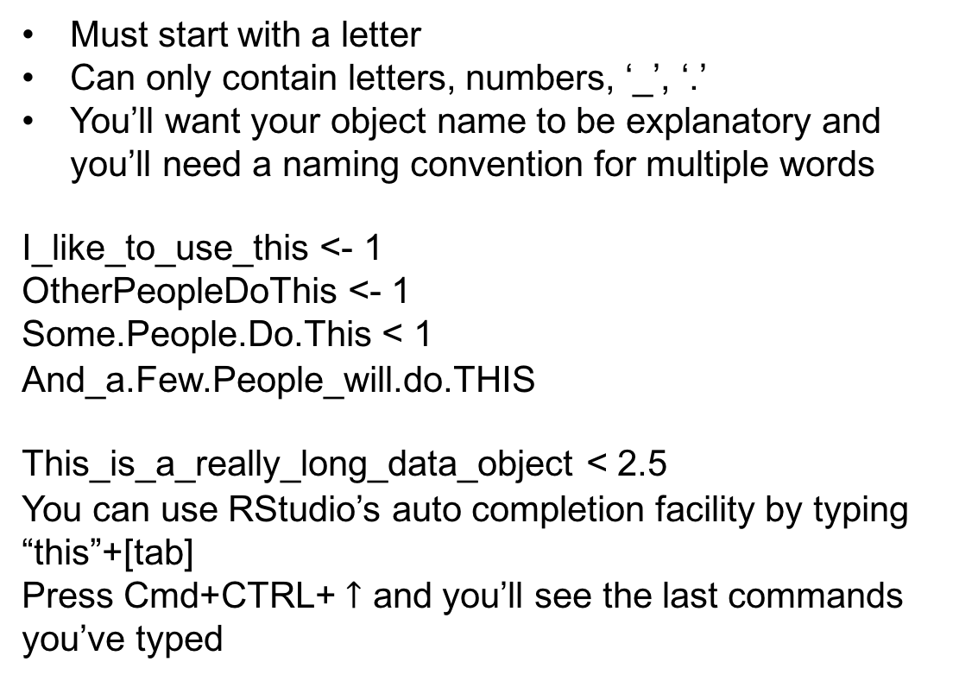
R - Objects
Must start with a letter
Can only contain letters, numbers, ‘_’, ‘.’
You’ll want your object name to be explanatory and you’ll need a naming convention for multiple words
I_like_to_use_this <- 1
OtherPeopleDoThis <- 1
Some.People.Do.This < 1
And_a.Few.People_will.do.THIS
This_is_a_really_long_data_object < 2.5
You can use RStudio’s auto completion facility by typing “this”+[tab]
Press Cmd+CTRL+ $↑$ and you’ll see the last commands you’ve typed
Notes:
Generally, while doing programming in any programming language, you need to use various variables to store various information. Variables are nothing but reserved memory locations to store values. This means that, when you create a variable you reserve some space in memory.
The variables are assigned with R-Objects and the data type of the R-object becomes the data type of the variable. There are many types of R-objects. The frequently used ones are

Slide 44
R – Objects continued
There are many types of R-objects. The frequently used ones are:
Vectors
Lists
Matrices
Arrays
Factors
Data Frames
#matrix_Example.R
Notes:
Generally, while doing programming in any programming language, you need to use various variables to store various information. Variables are nothing but reserved memory locations to store values. This means that, when you create a variable you reserve some space in memory.
The variables are assigned with R-Objects and the data type of the R-object becomes the data type of the variable.

Slide 45
Vector Object
6 data types of vectors
Logical
Numeric
Integer
Complex
Character
Raw
Notes:
Generally, while doing programming in any programming language, you need to use various variables to store various information. Variables are nothing but reserved memory locations to store values. This means that, when you create a variable you reserve some space in memory.
The variables are assigned with R-Objects and the data type of the R-object becomes the data type of the variable.

Slide 46
Data types
int – integer - as.integer(3.14) = 3
dbl – double or real number - 1, 2.5, 4.5
chr – character vector/ string - character
dttm – date-time – 2017-01-01
lgl – logical – TRUE or FALSE
fctr – factors R uses to represent categorical variables with fixed possible values
date – dates - as.Date(as.POSIXct("2013-01-01 07:00", 'GMT') [1] "2013-01-01"
Notes:
Fctr – colors (red, blue, green, yellow) and are not numbers

Slide 47
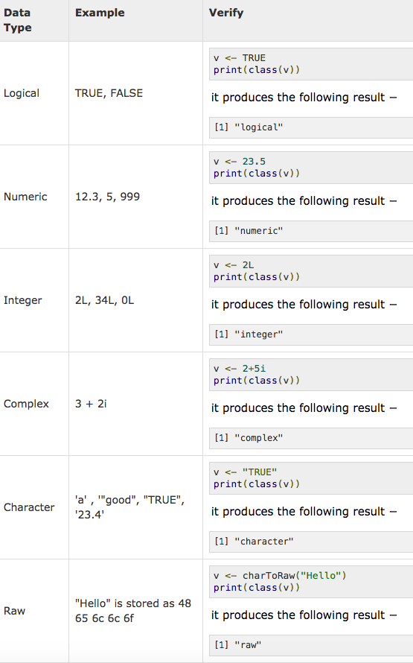

Slide 48
Exercise 1
Use R Studio to answer the following questions
a. Which of the following is a logical operator?
/ | - ^
b. What value does R return in the statement below?
3 >= 4
c. What is the result of this calculation?
(45 + 3) * 43 + 3^2
d. How would R evaluate the following?
carspeed <- 70
speedlimit <- 65
carspeed > speedlimit
e. How would R evaluate the following?
(2+2 == 4) | (2+2 == 5)
f. How would R evaluate the following?
!FALSE
g. What is the result of this function?
round(33.2321435452, 2)
h. What is the result of this function?
sqrt (64)
i. What is the result of this statement?
sqrt(64) == 64 ^.5
j. What is the result of this statement?
15
abs(-32)
k. Which of the following is an arithmetic operator?
*, |, &, !
l. What is wrong with this code?
2 + 3 *4 + sqrt[100]

Slide 49
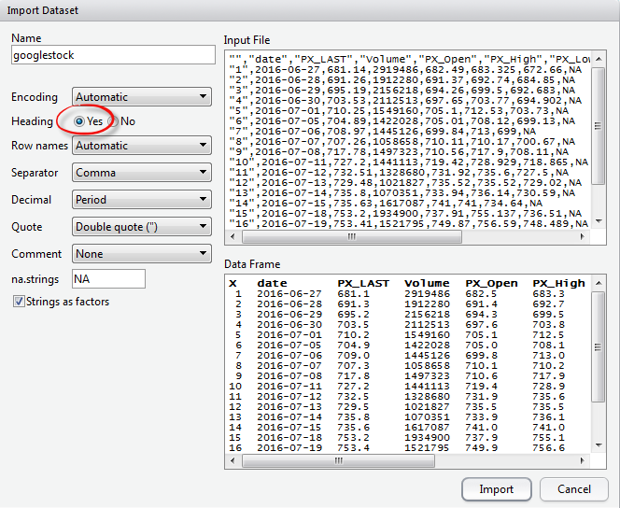
Import
Notes:
*Review FLDS go in Bloomberg Terminal FLDS PRICE

Slide 50
Hands on challenge 2
Using the UN_gdp_data.csv
Import that data frame to R
Write your new data frame to csv
View the data frame in R
What are the dimensions of the dataframe?
How many columns are there in the dataframe?
What class type is continent?
What is the result of the 1st column and 2nd row?
Notes:
Bonus
FLDS
“Ceo name“
“Ceo” – for salary

Slide 51
Section 2
Course Layout:
Section 1 -Familiarity with R
Section 2 – Data Wrangling
Data store types
Tidying
Dplyr
Hands On Challenge 3
Section 3 – Data Visualization

Slide 52
Dplyr Tidying
In this section we are going to learn the key dplyr functions that allow you to perform data-manipulation tidying
filter() - pick observations by their values
arrange() – reorder the rows
select() – pick variables by their names
mutate() – create new variables with functions of existing varables
summarize() – collapse many variables down to a single summary
group_by() – changes the scope of each function from operating on the entire data set to operating on it group-by-group

Slide 53
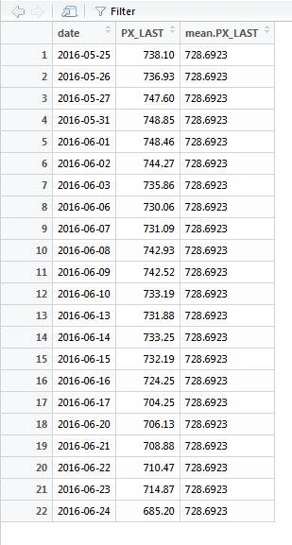
Transformation
Data summaries provide overviews of key properties of the data
Goal is to describe important properties of the distribution of the values across observations that were measured
Implying knowledge generation against the dataset
Subset
Mathematical functions
Calculations
Summary statistics
sorting

Slide 54
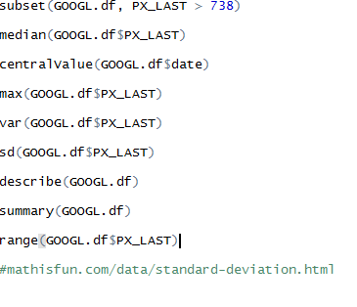
Transformation continued…
Mean – average
Median – middle value
Mode – most common value
Range – difference between the largest and the smallest value
Variance – numerical measure of how the data values are dispersed around the mean. The average of the squared distances from the mean
Standard deviation – a measure of how spread out the numbers are

Slide 55
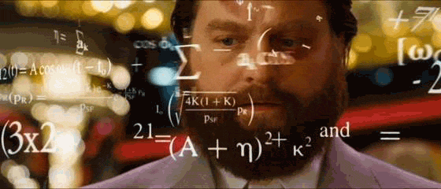

Slide 56
Hands on challenge 3
Using the UN_gdp_data.csv
Which Country has the largest population?
Hint: Use max & subset
Which Country has the lowest lifeExp?
Which Continent has the highest population in the most recent year?
How many row entries are there by Continent?

Slide 57
Section 3
Course Layout:
Section 1 -Familiarity with R
Section 2 – Data Wrangling
Section 3 – Data Visualization
Data Viz framework
Code plotting
Hands On Challenges
https://stat.ethz.ch/R-manual/R-devel/library/base/html/Memory-limits.html
Notes:
More on the nuts and bolts or under the hood of the R engine here.
R stores all objects in memory
It can process 8TB of RAM on 64bit operating systems
Rules of the Road for Big Data and R
R can process up to 1 million records with ease
For greater than 1 million and less than 1 billion records, R may struggle to process the data
If you’ve got greater than 1 billion records, its best to use big data platforms that leverage map reduce and processed on big data platforms like Hadoop
Memory Limits in R
https://stat.ethz.ch/R-manual/R-devel/library/base/html/Memory-limits.html

Slide 58
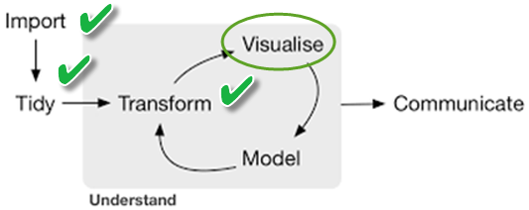
Next up…visualize
http://r4ds.had.co.nz/intro.html
*Hadley Wickham is from New Zealand and that’s how they spell “visualise”
Notes:
Double circle around Communicate because its an important product of Visualise

Slide 59
Data Visualization with R
R – practically every chart type is available via some R package
R programming can help you get a lot done with much less effort if you were to do the visualizations by hand
Automation with Visualization is your friend
Remember to be the human and translate raw computer data to visuals that humans understand

Slide 60
Data Viz chart types
Bar Chart
Pie Chart
Histogram
Time Series
Box plots
Scatter Plots
Bubble Charts
Tree Map
Geospatial Maps

Slide 61
Coding plots
plot {graphics}
Description
Generic function for plotting of R objects.
Usage
plot(x, y, …)
x | the coordinates of points in the plot. Alternatively, a single plotting structure, function or any R object with a plot method can be provided.
y | the y coordinates of points in the plot, optional if x is an appropriate structure.
main - an overall title for the plot
sub - a sub title for the plot
xlab - a title for the x axis
ylab - a title for the y axis
*Use the “table” function to filter data by categories table - Cross Tabulation and Table Creation. Table uses the cross-classifying factors to build a contingency table of the counts at each combination of factor levels.
Notes:
-When you give something your all, you give it 100%. Unless you work for Fox Chicago then you give it 193%
- Pie charts are to add to 100% not 193%

Slide 62
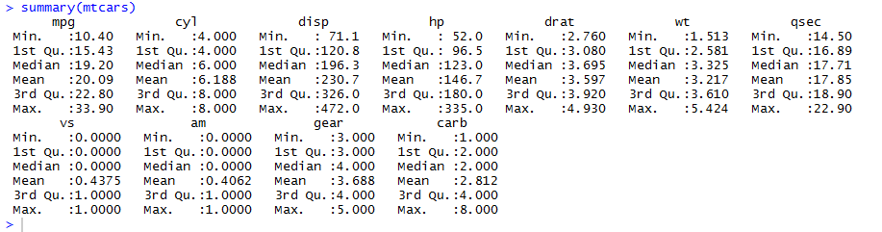
Cars example
# Cars Examples
attach(mtcars)
View(mtcars)
names(mtcars)
summary(mtcars)
Notes:
Switch to mtcars example attachment dataframe

Slide 63
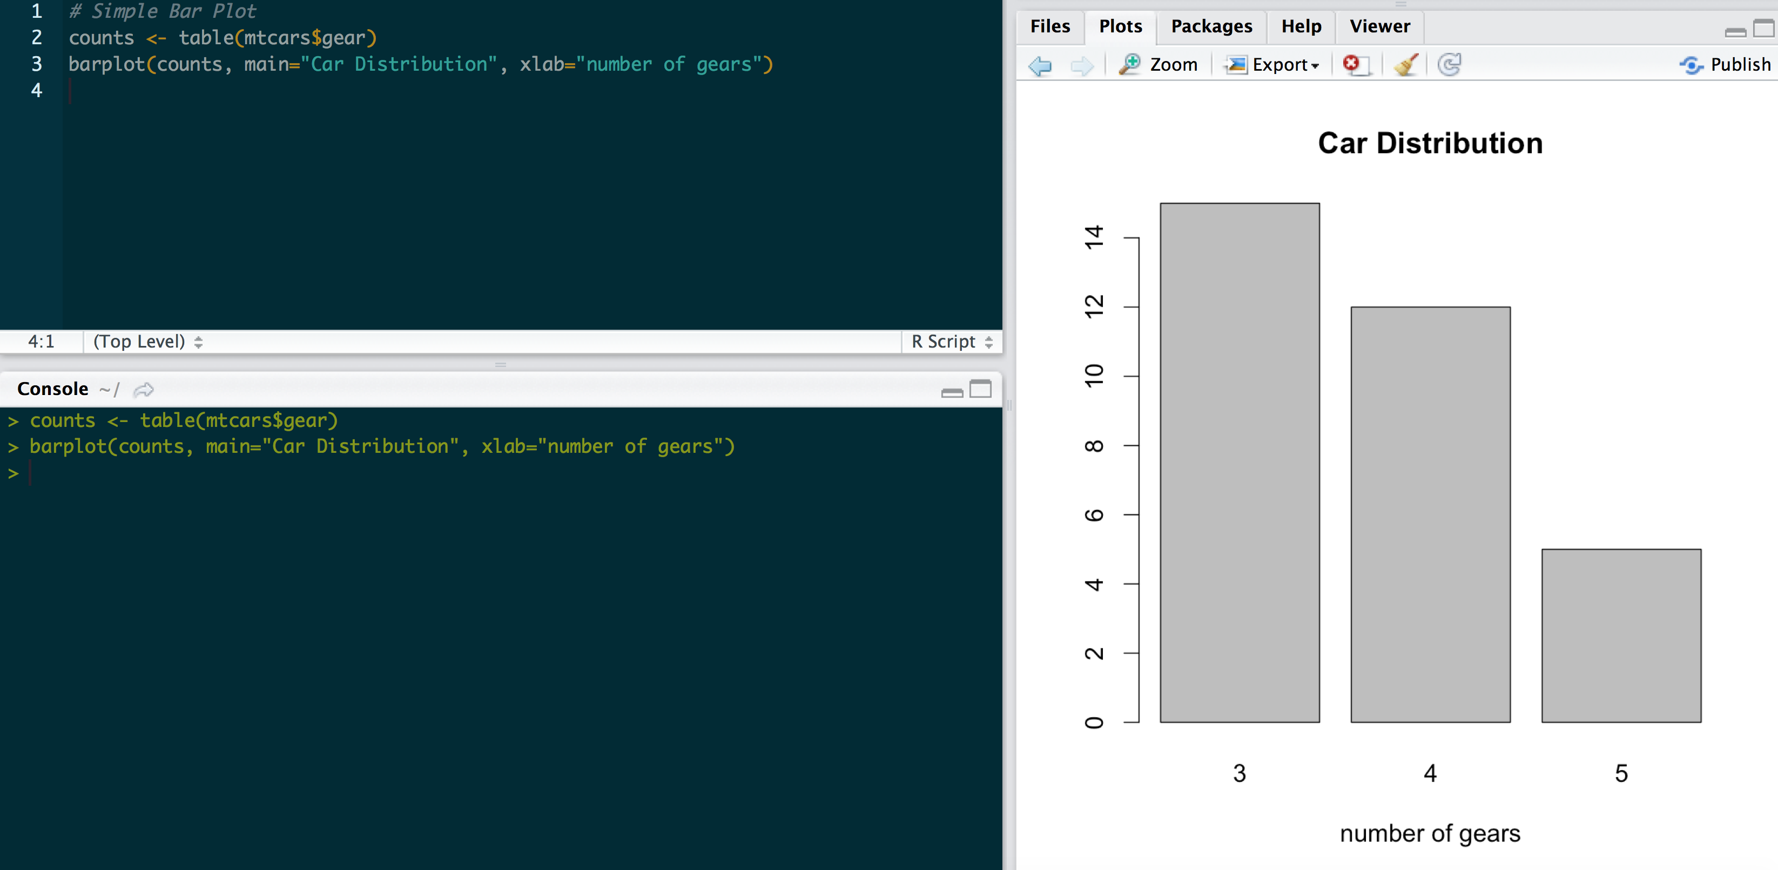
Data Viz < Bar Chart

Slide 64
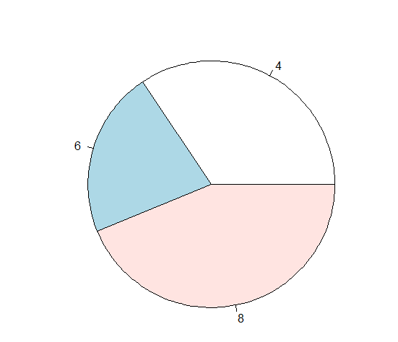
Piechart
#piechart
pie(table(mtcars$cyl))

Slide 65
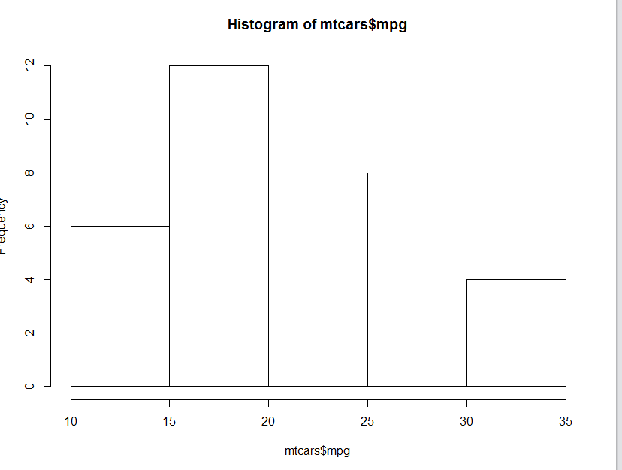
histogram
#histogram
hist(mtcars$mpg)

Slide 66
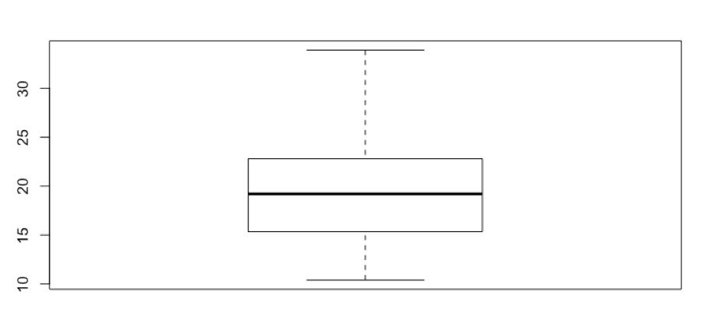
Box plot
#Distribution of mpg
boxplot(mtcars$mpg)

Slide 67
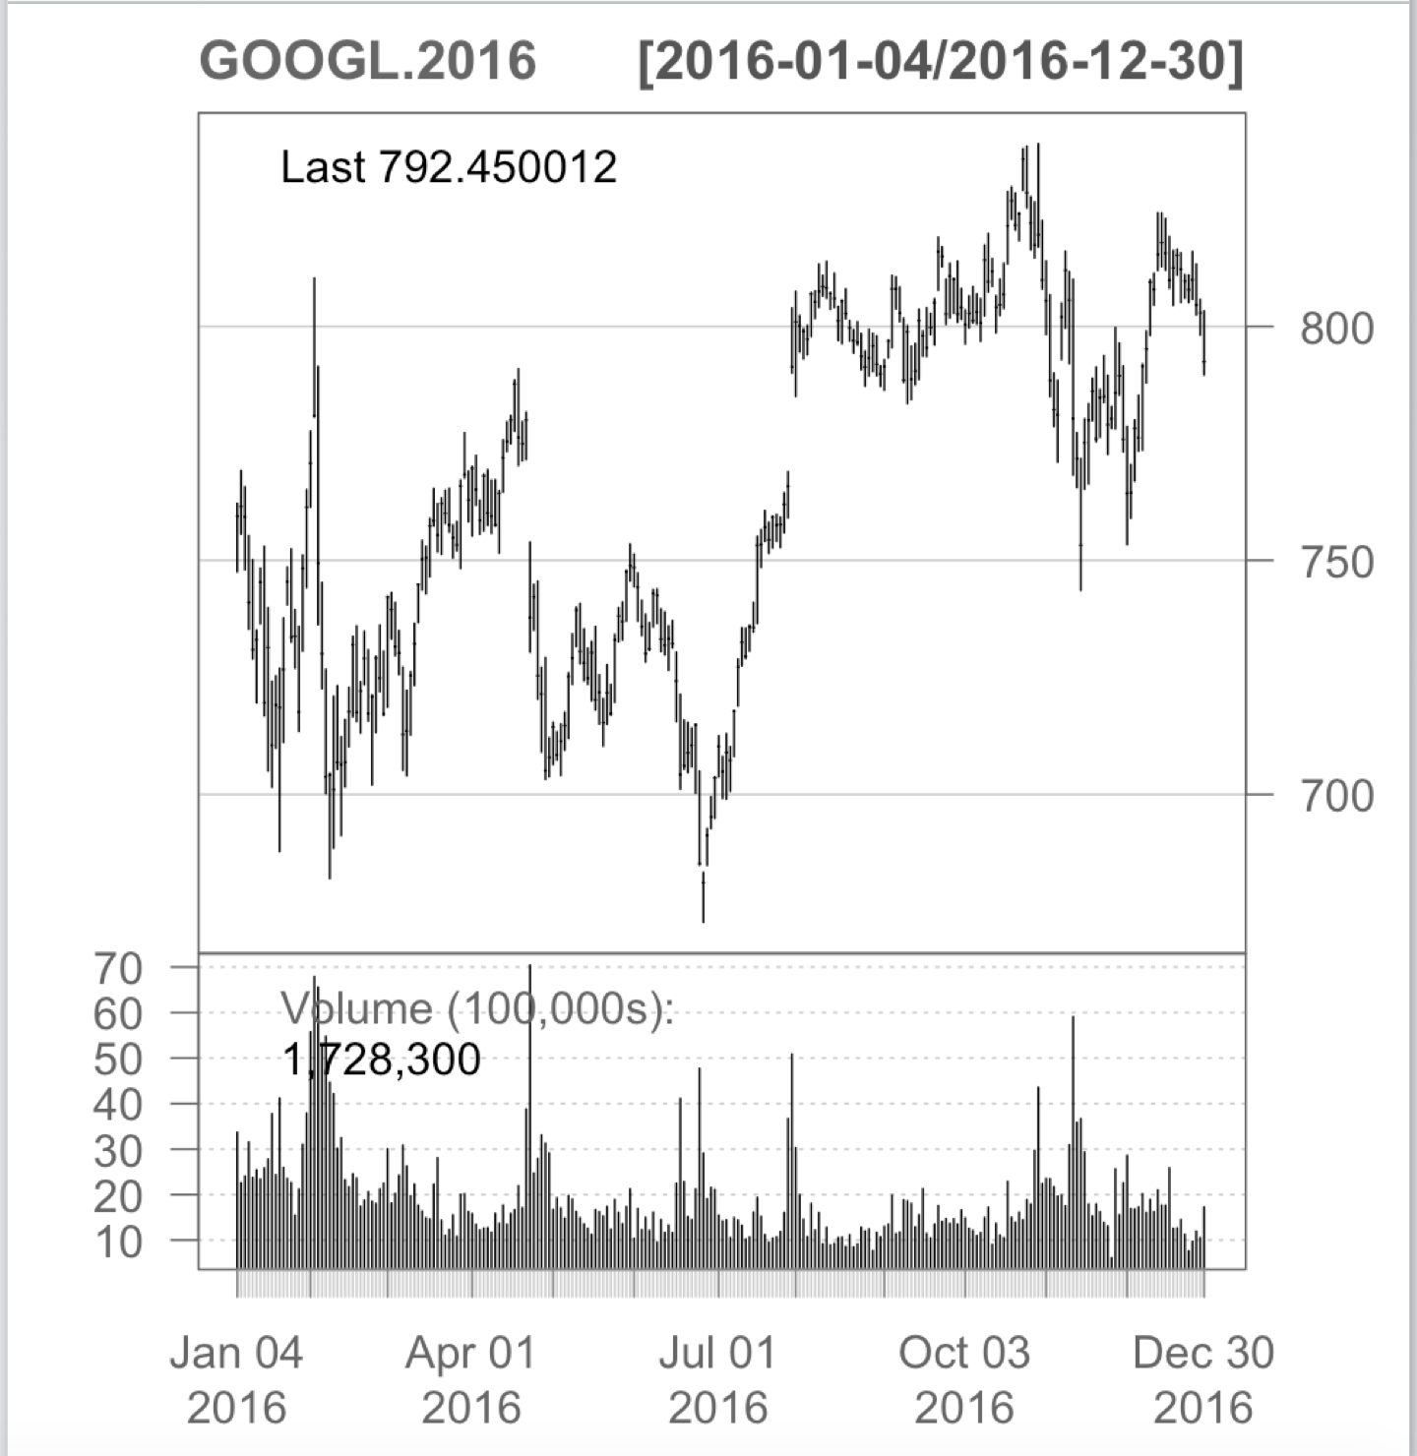
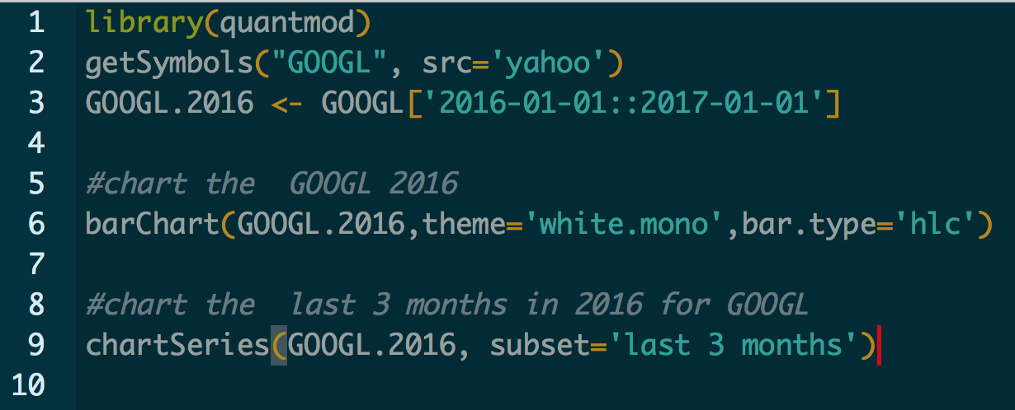
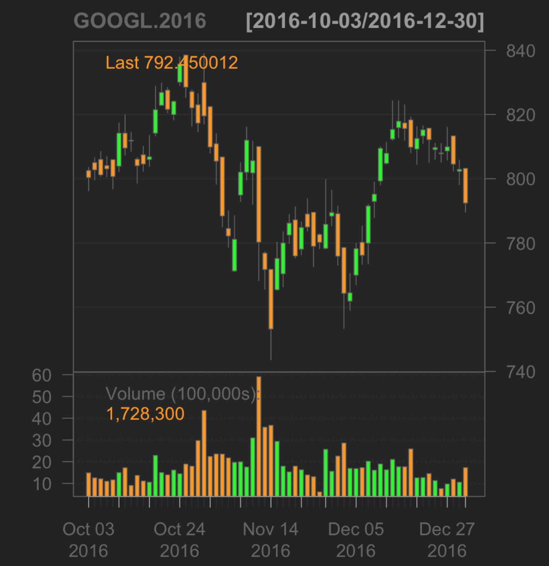
Time series plot

Slide 68
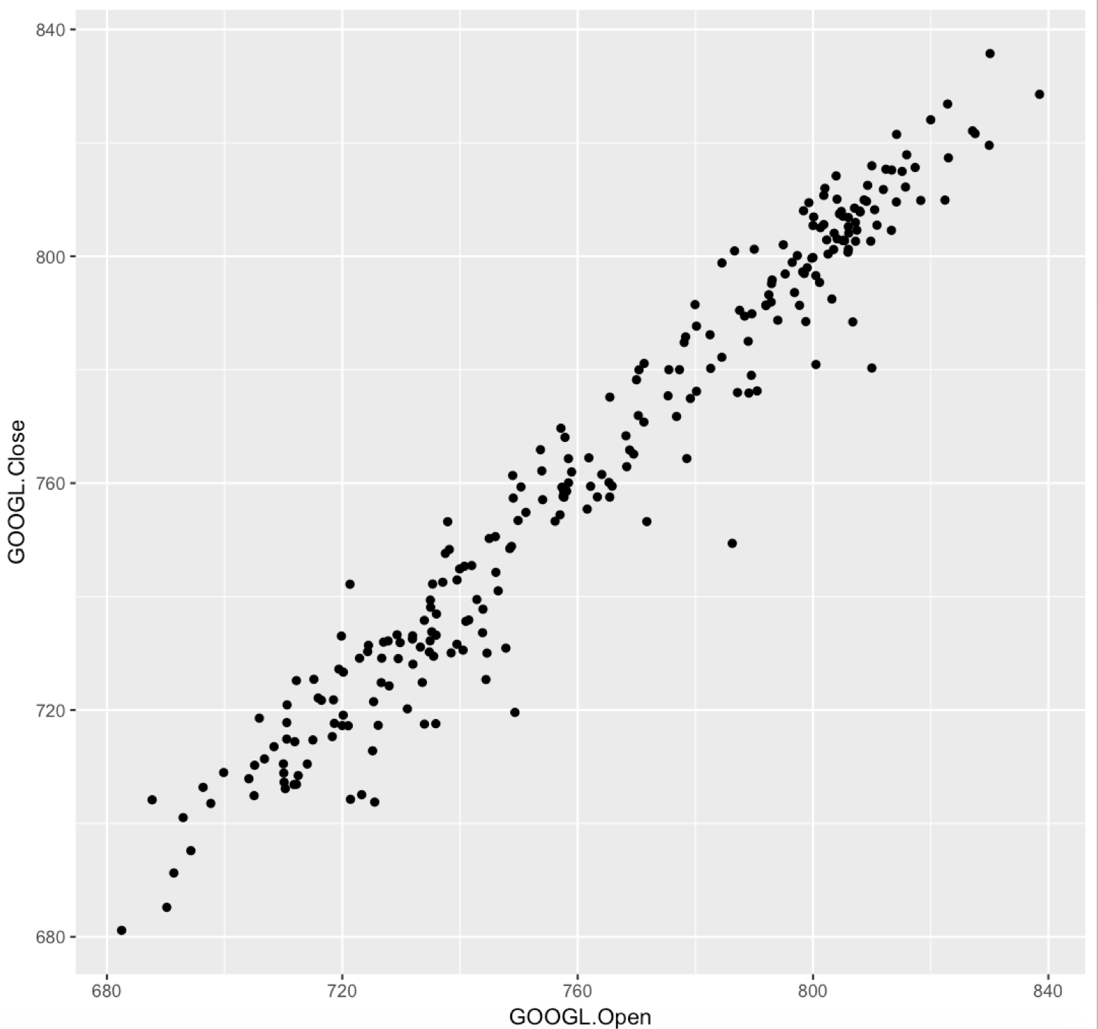
Scatter Plot
#scatter plot
library(ggplot2)qplot(GOOGL.Open, GOOGL.Close, data = GOOGL.2018, geom = "point")
Notes:
Notice the outliers of volume for stock purchases of Google s

Slide 69
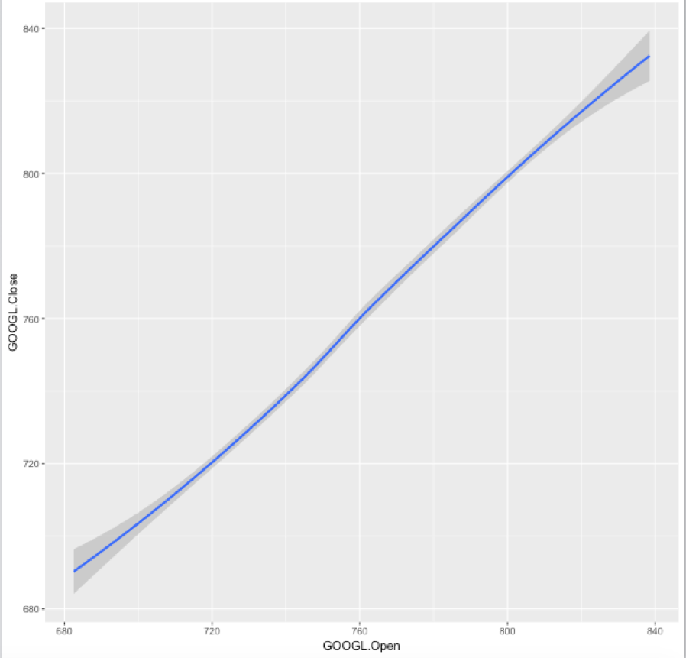
Scatter Plot 2
#scatter plot 2
#scatter plot upgrade 1 qplot(GOOGL.Open, GOOGL.Close, data = GOOGL.2018, geom = "smooth")

Slide 70
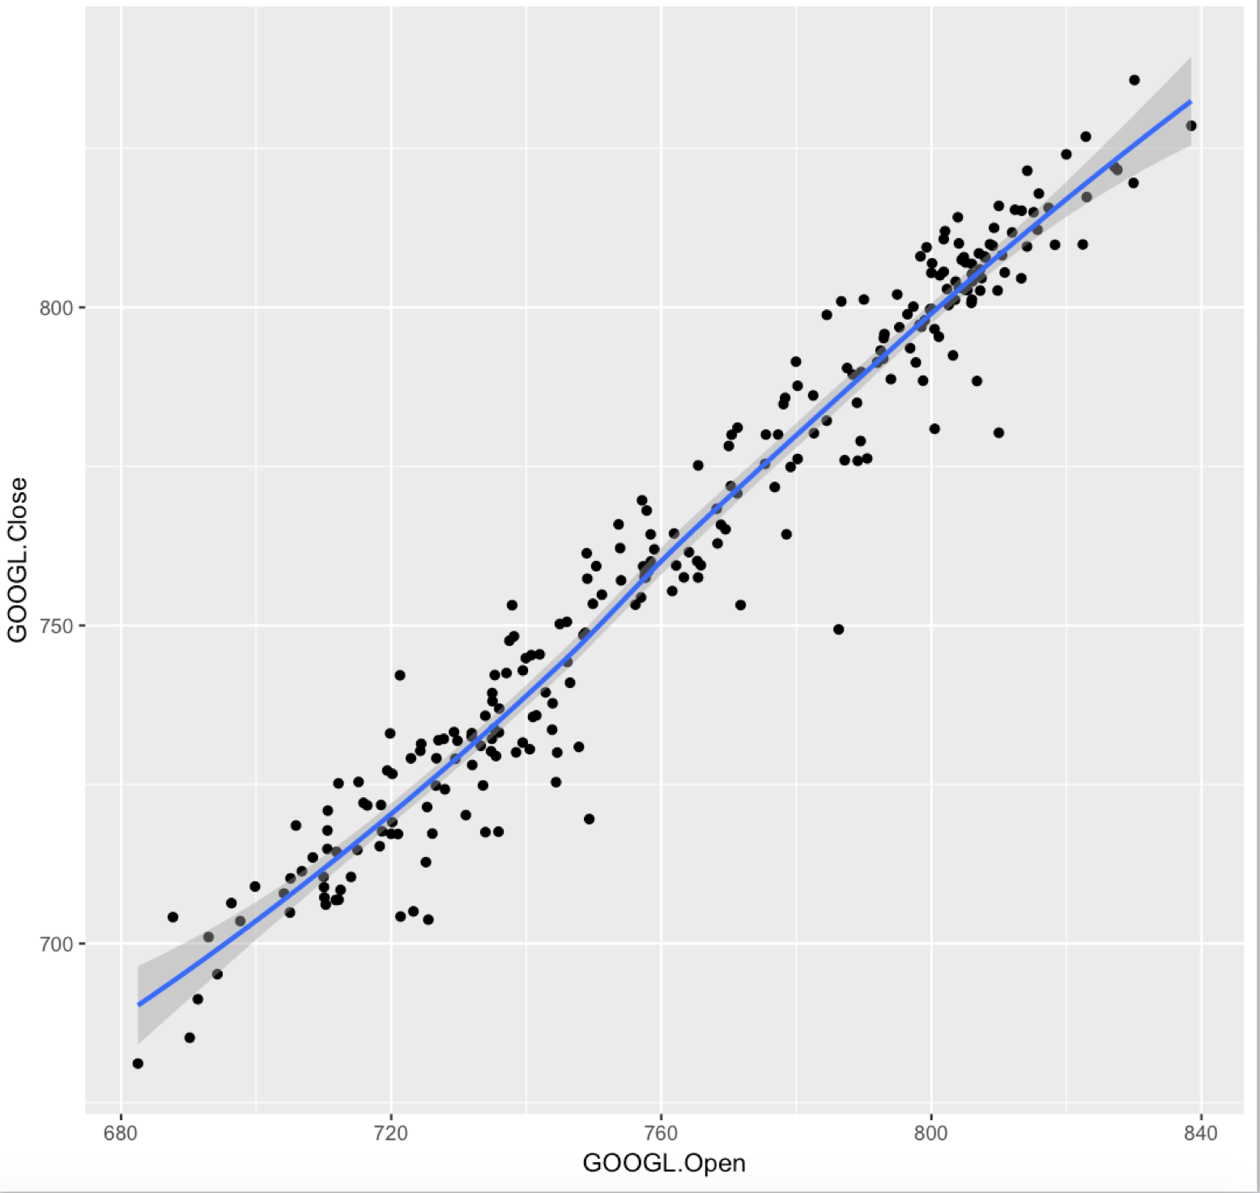
Scatter Plot 3
#scatter plot 3
# qplot(GOOGL.Open, GOOGL.Close, data = GOOGL.2018, geom = c("point","smooth"))
Notes:
LOESS Curve Fitting (Local Polynomial Regression) Menu location: Analysis_LOESS. This is a method for fitting a smooth curve between two variables, or fitting a smooth surface between an outcome and up to four predictor variables. The procedure originated as LOWESS (LOcally WEighted Scatter-plot Smoother).

Slide 71
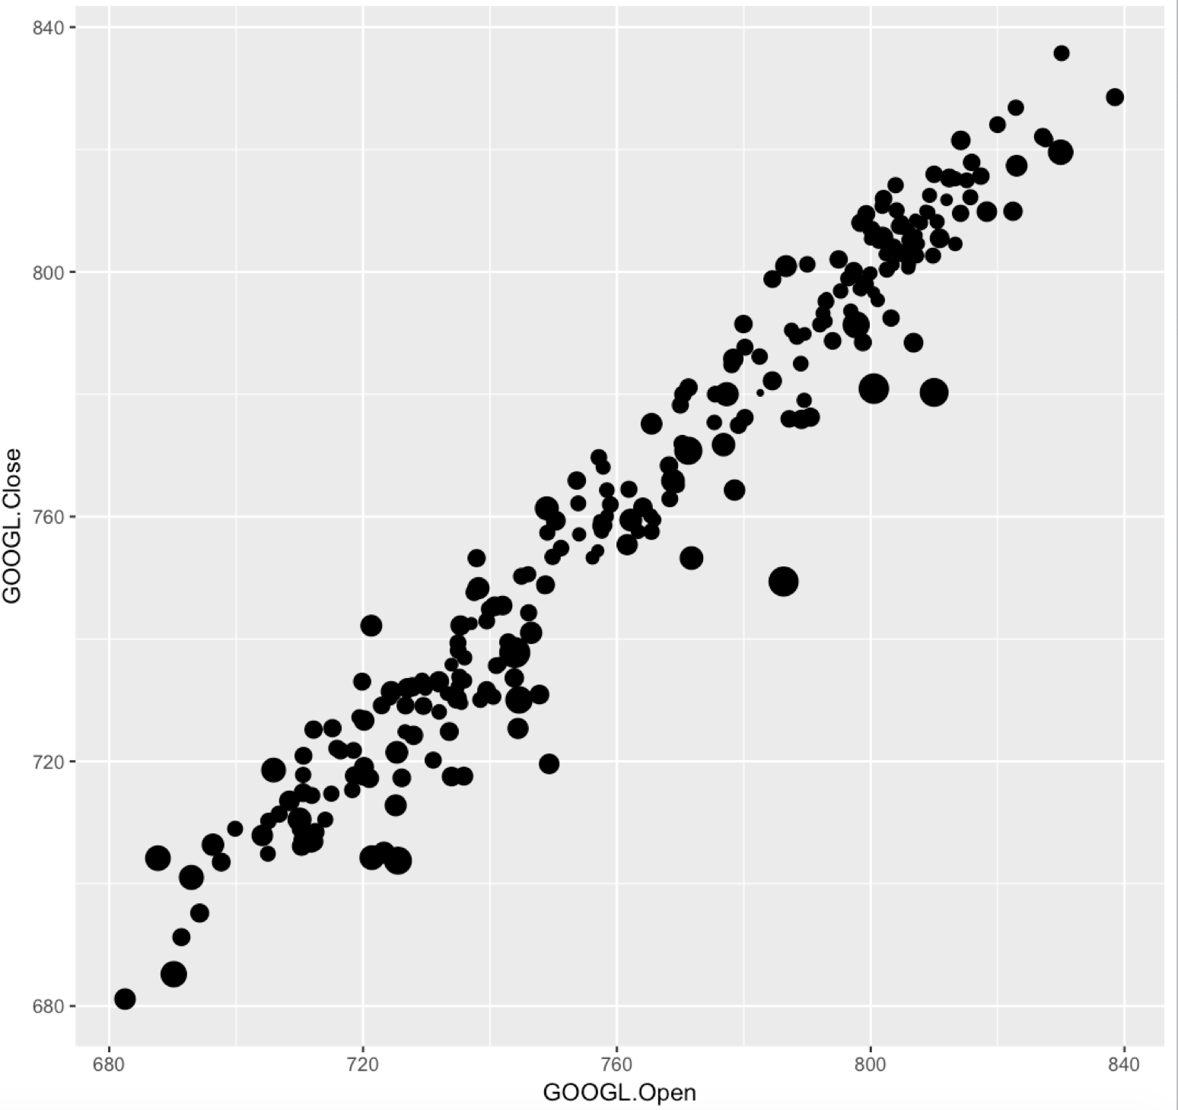
Bubble Chart
#Bubble Chart
# ggplot(data=GOOGL.2018, aes(x=GOOGL.Open, y=GOOGL.Close)) + geom_point(aes(size=GOOGL.Volume)) + theme(legend.position = "none")
Notes:
Adding a 3rd dimension to measure

Slide 72
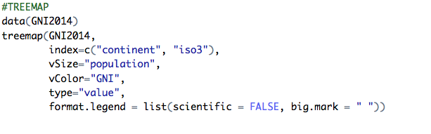
TreeMap
Notes:
Adding a 3rd dimension to measure

Slide 73
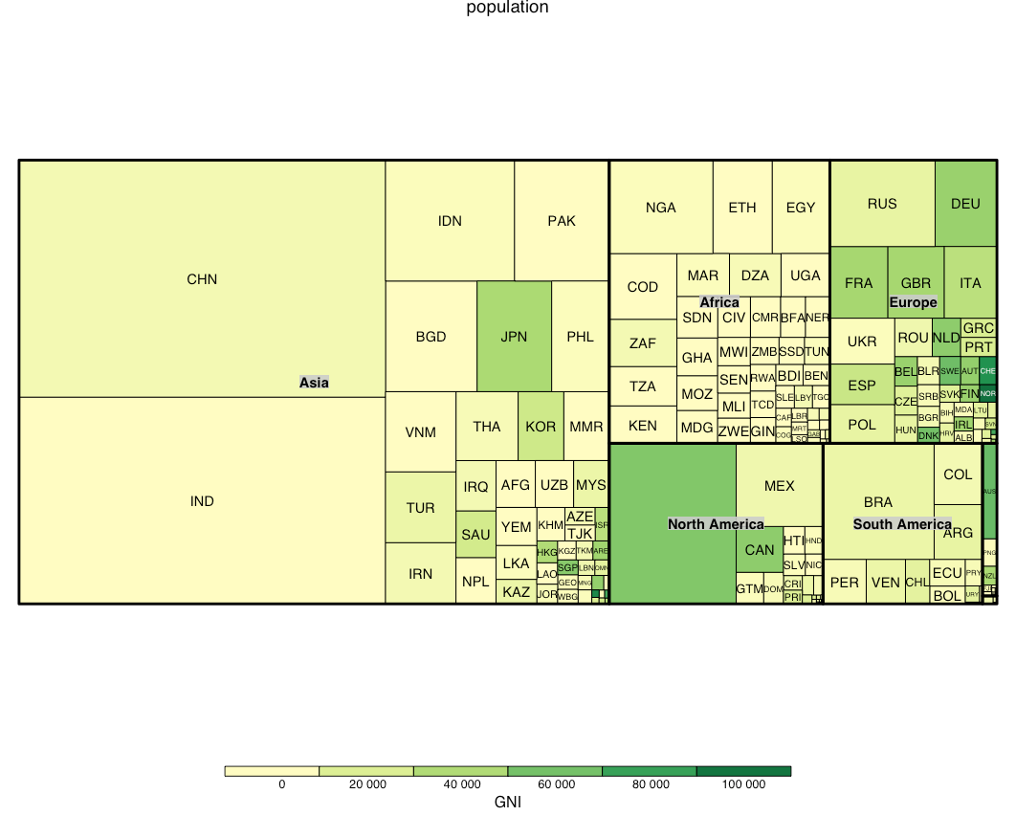
TreeMap
Notes:
Adding a 3rd dimension to measure

Slide 74
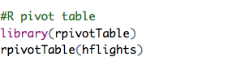
Rpivot Table

Slide 75
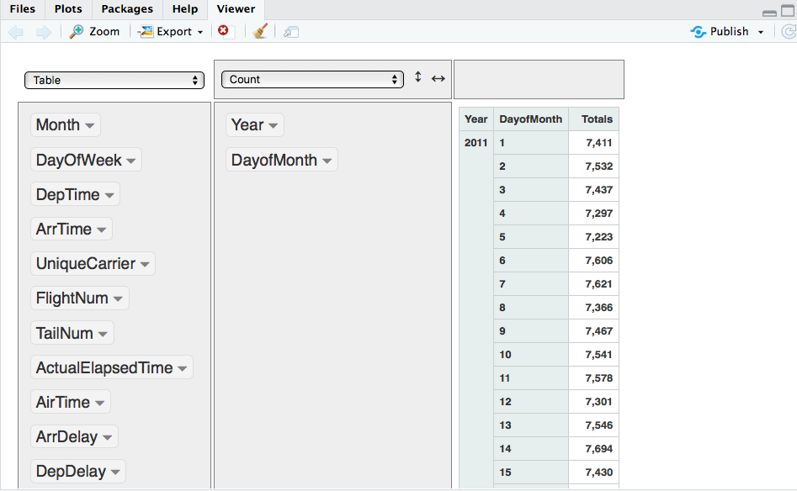

Slide 76
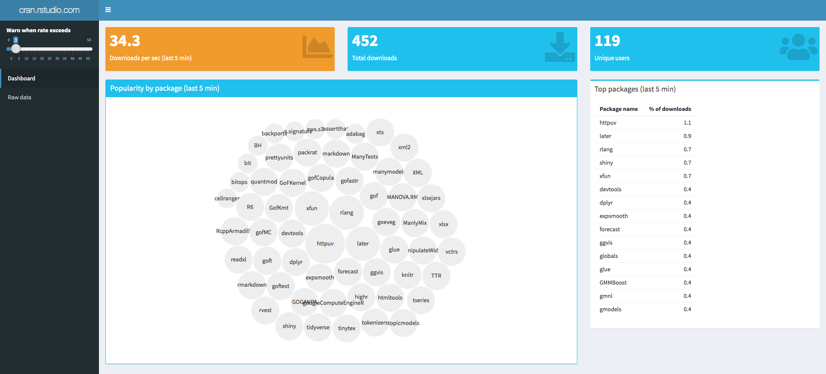
R Shiny Dashboards
https://gallery.shinyapps.io/087-crandash/

Slide 77
The END
Contact Info:
Brennan Lodge
LinkedIn: https://www.linkedin.com/in/brennanlodge/
Twitter: @Blodge8
Lodge.brennan@gmail.com
Available for onsite trainings

